Slide 1
The Cool Code Consortium
8-8-2017
Notes:
Use this for Pro Audio Segments

Slide 2
Stuff
Cool Things
Cool News
Computer Music
Portable Components for Axient Digital

Slide 3
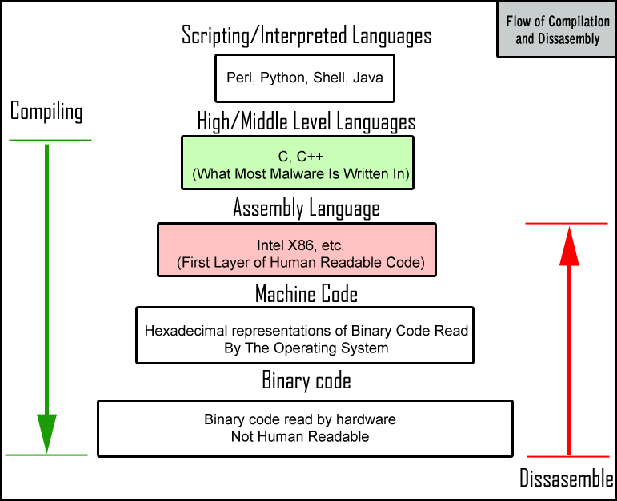

Slide 4
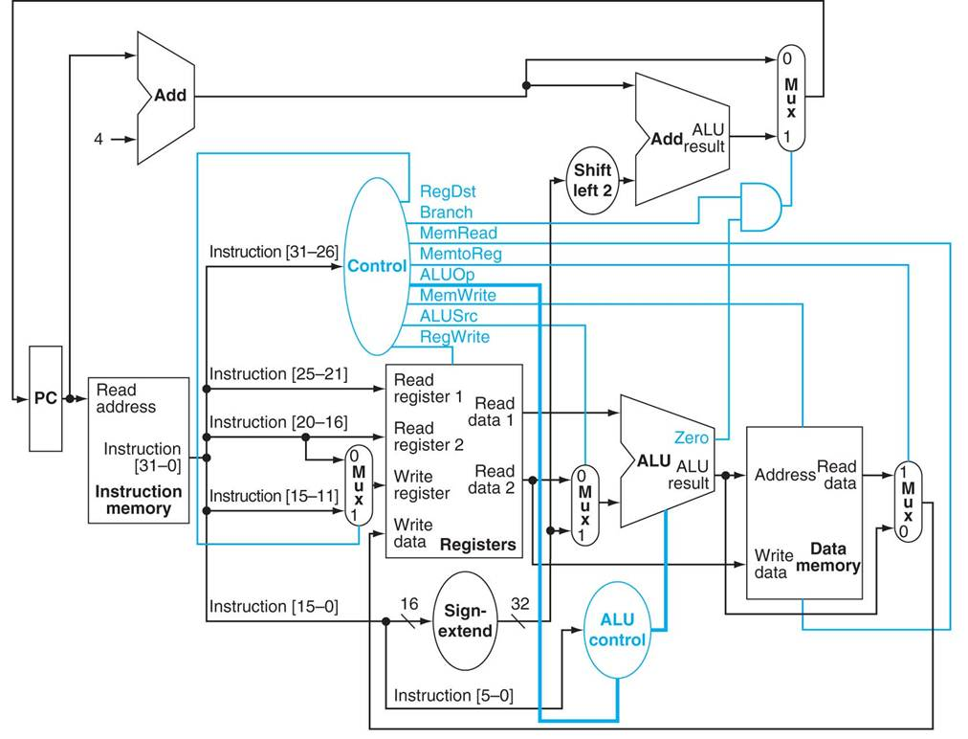

Slide 5
Cool Things
Facebook Group
Picture

Slide 6
Cool News
https://www.sciencedaily.com/releases/2017/08/170803100019.htm
http://sdtimes.com/heptio-two-open-source-projects-kubernetes-operations/
http://sdtimes.com/rise-automation-coding-becoming-job-everyone/
http://spectrum.ieee.org/static/interactive-the-top-programming-languages-2017

Slide 7
Computer Music

Slide 8
Portable Components for Axient Digital

